Slide 1
TUTORIAL SESSION - 3
TECHNICAL STRUCTURE

Slide 2
OBJECT AND MECHANISM DESCRIPTION

Slide 3
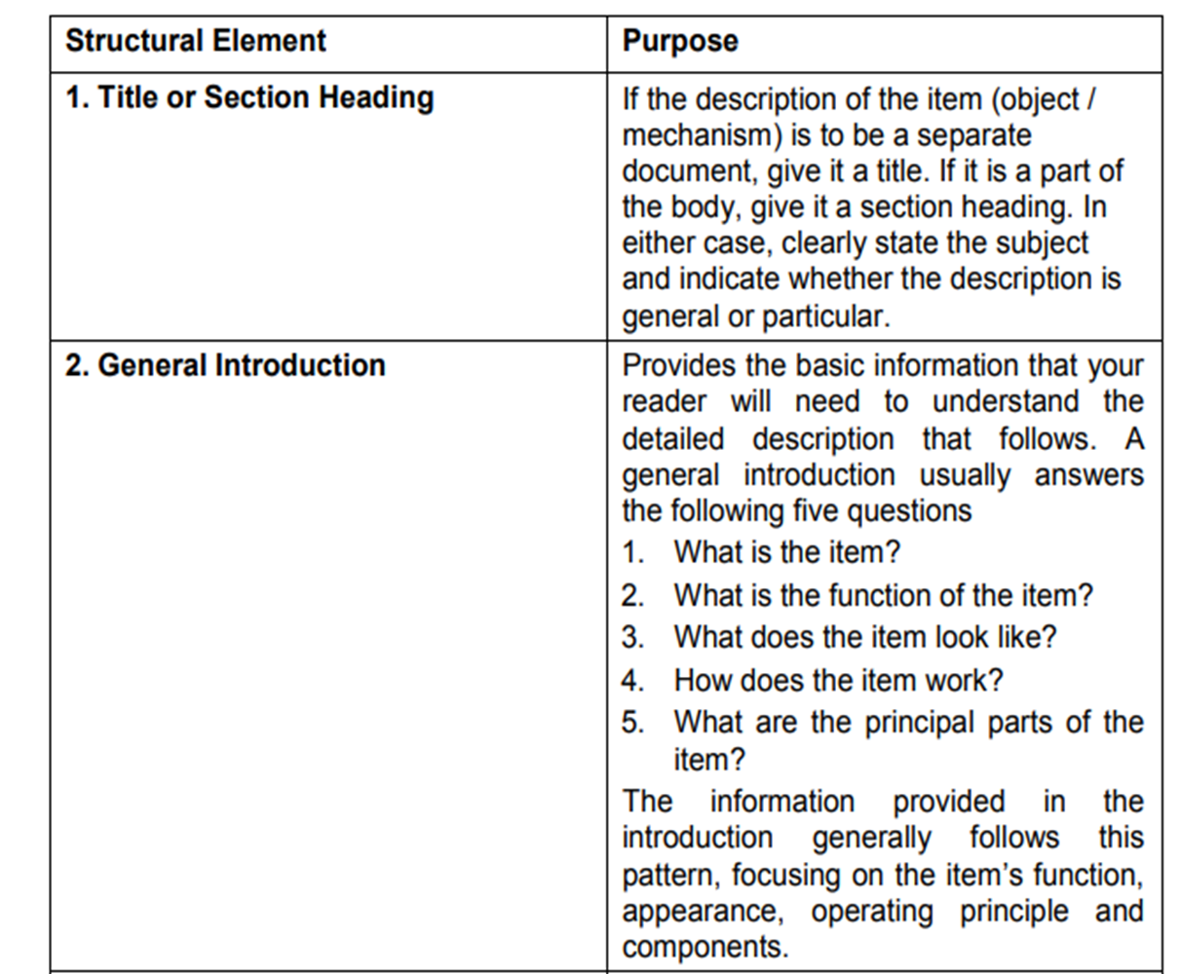

Slide 4
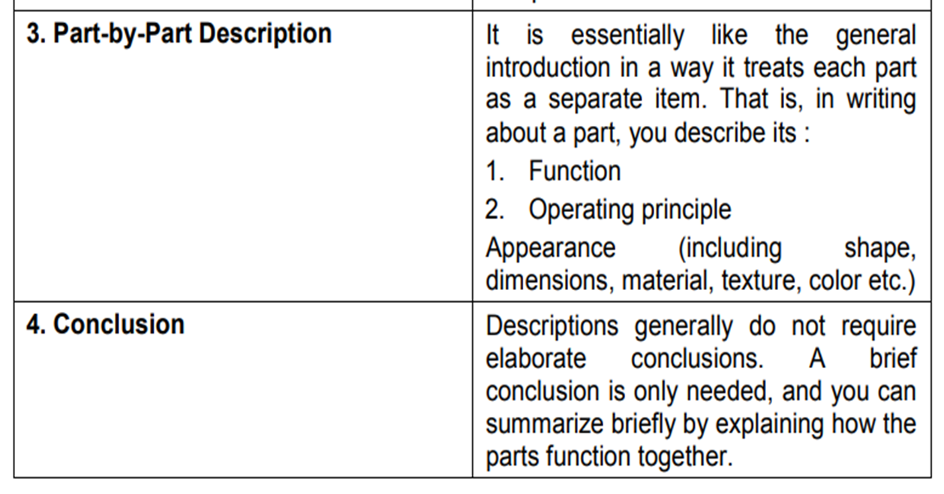

Slide 5
Process Description

Slide 6
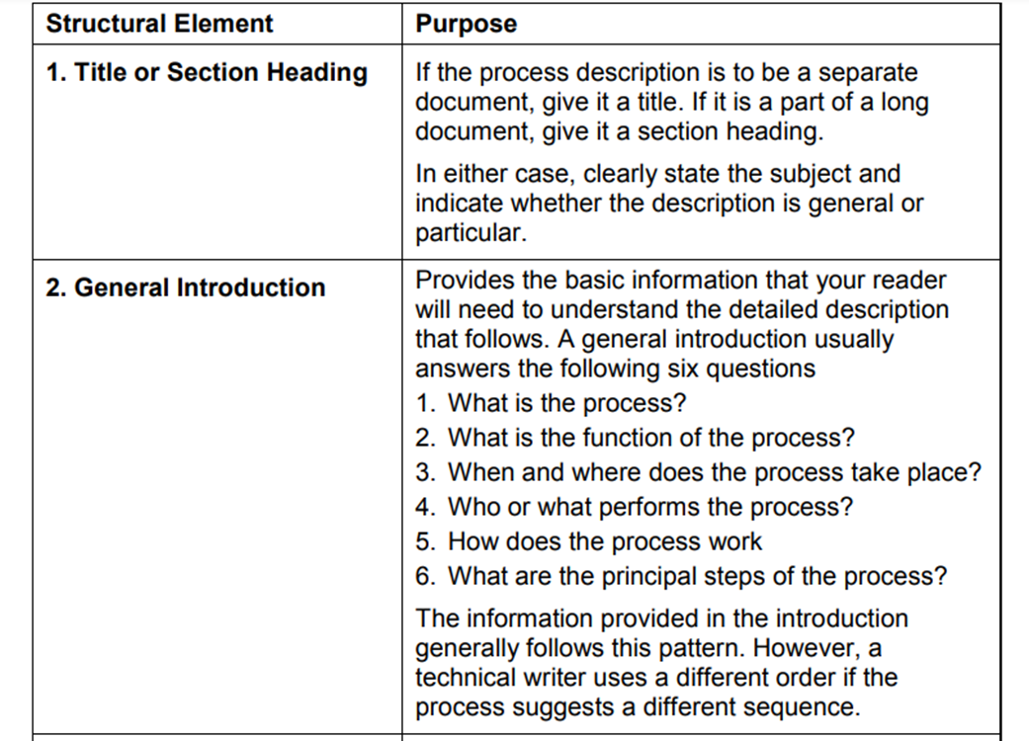

Slide 7
